Slide 1
LINEAR REGRESSION
MODELLING THE RELATIONSHIP FROM THE DATA
2 TYPES:
SIMPLE LINEAR REGRESSION
MULTIPLE LINEAR REGRESSION

Slide 2
SIMPLE LINEAR REGRESSION
Independent variable
($x_{1}$)
Independent variable
(𝑥_1)
LINEAR REGRESSION
PREDICTION

Slide 3
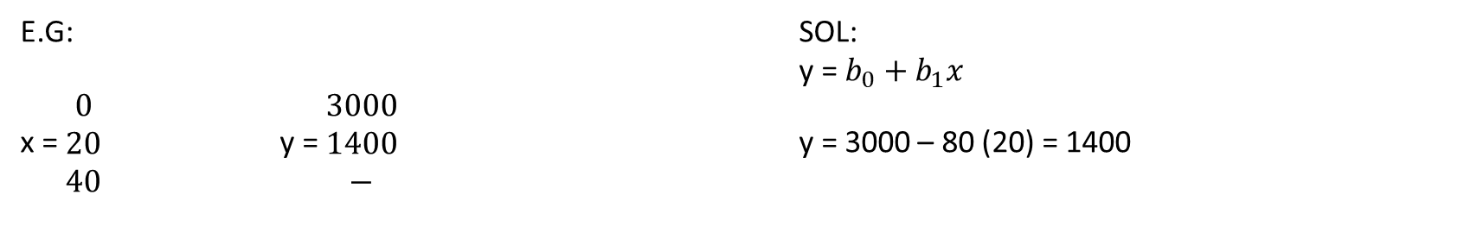

SIMPLE LINEAR REGRESSION
PREDICTOR (independent) VARIABLE – x
TARGET (dependent) VARIABLE – y
y = $b_{0}+b_{1}x$where, $b_{0}=intercept$ $b_{1}=slope$
E.G: SOL:
y = $b_{0}+b_{1}x$
x = $\begin{matrix}0 \\ 20 \\ 40\end{matrix}$ y = $\begin{matrix}3000 \\ 1400 \\ −\end{matrix}$ y = 3000 – 80 (20) = 1400

Slide 4
MULTIPLE LINEAR REGRESSION
Multiple Independent variables
($x_{1} , … x_{n}$)
Multiple Independent variables
(𝑥_1 , … 𝑥_𝑛)
LINEAR REGRESSION
PREDICTION

Slide 5
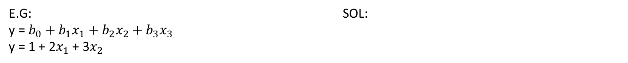

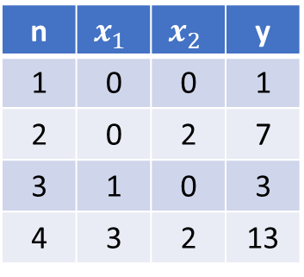
MULTIPLE LINEAR REGRESSION
PREDICTOR (independent) VARIABLE – $x_{1},x_{2},x_{3}…$
TARGET (dependent) VARIABLE – y
y = $b_{0}+b_{1}x_{1}+b_{2}x_{2}+b_{3}x_{3}$ where, $b_{0}=intercept$ $b_{1}=parameter of x_{1}$
$b_{2}=parameter of x_{2}$
n | $$x_{1}$$ | $$x_{2}$$ | y
1 | 0 | 0 | 1
2 | 0 | 2 | 7
3 | 1 | 0 | 3
4 | 3 | 2 | 13
E.G: SOL:
y = $b_{0}+b_{1}x_{1}+b_{2}x_{2}+b_{3}x_{3}$
y = 1 + 2$x_{1}$ + 3$x_{2}$

